Slide 1
Tech for Kids Confidential

Slide 2
Technology is changing the world!
Tech for Kids Confidential

Slide 3
LEARN DIFFERENT

Slide 4
The leading education provider on tech and entrepreneurship learning for the next generation!
Tech for Kids Confidential
Notes:
Simplify the profile

Slide 5
Vision
To be the leading learning path that bridges students to their best innovation through the 21st cenury skills and technology practices in ASIA
Mission
Tech for kids provides and ensures a new dynamic and practical learning and teaching environment where students can best learn, think and apply their knowledge to bring their project to life by using technological innovation concepts through:
Artificial Intelligence (AI),
Robotic and Engineering,
Coding,
Digital Citizenship and Entrepreneurship programs.
Tech for Kids Confidential
Notes:
Simplify the profile

Slide 6
Goals
To accomplish the aforementioned mission, Tech for Kids aims to:
Ensure the quality and relevancy of the programs to real-world innovations
Build a lifelong learning and self-explored habit
Ignite the creativity in every student
Foster a collaborative and teamwork environment
Open to the free exchange of ideas between students and mentors
Enhance the 21st century skills
Connect students to the world of innovation space and tech eco-system
Spark student engagement with a new way of learning, thinking and creating
Open doors to endless possibility through tech-education
Tech for Kids Confidential
Notes:
Simplify the profile

Slide 7
Programs for Primary, Secondary and High School Level
Computer Science
Fundamental Program
Robotic and Engineering Program
Artificial Intelligent (AI) Program
Entrepreneurship Program
Coding for Kids
Coding for Kid 1: Course A
Coding for Kid 2: Course B
Coding for Kid 3: Course C
Young Coders
Young Coder 1: Course D
Young Coder 2: Course E
Young Coder 3: Course F
Young Developers
Young App Dev
Young Web Dev
Young Game Dev
Introduction to Robotic (Assemble and Program on robot Q-Scout)
Robotic and Engineering ll
Electronic: 1&2
Robotic and Construction: 1&2
3D Printing: 1&2
AI for Kids
(Introduction to AI and Build Machine Learning Model integrated with App Inventor and Scratch)
AI Family Challenge
(Annual AI Global Competition)
Junior Kidpreneurs
Senior Kidpreneurs
(Unleash the kid’s entrepreneurial potential)
Tech for Kids Confidential

Slide 8
LEARNING ROADMAP by Group Age
Age 6-7
Age 7-8
Coding for Kids 1
ARTIFICIAL INTELLIGENT PROGRAM
Age 8-9
Age 9-10
Age 10-11
Age 11-12
Age 12-13
Age 13-14
Age 14-15
Introduction to Robotic
Coding for kids 3
Young Coder 1
Young Coder 3
Young Coder 2
Young App Developer
Electronic: 1&2
Robotics: 1&2
3D Printing 1&2
AI for Kids
AI Family Challenge
Senior Kidpreneurs
Junior Kidpreneurs
Young Web Developer
Young Game Developer
AGE GROUP
CS FUNDAMENTAL PROGRAM
ROBOTIC AND ENGINEERING
ENTREPRENEURSHIP PROGRAM
Coding for kids 2
Tech for Kids Confidential

Slide 9
Teaching Methodology
Project base learning
Customized and localized curriculum
Simulation
Instructed by industrial experts
Lifelong learning approach
Dynamic classroom
“Been there, done that” experience sharing
Animation or/and real characters video
Tech for Kids Confidential

Slide 10
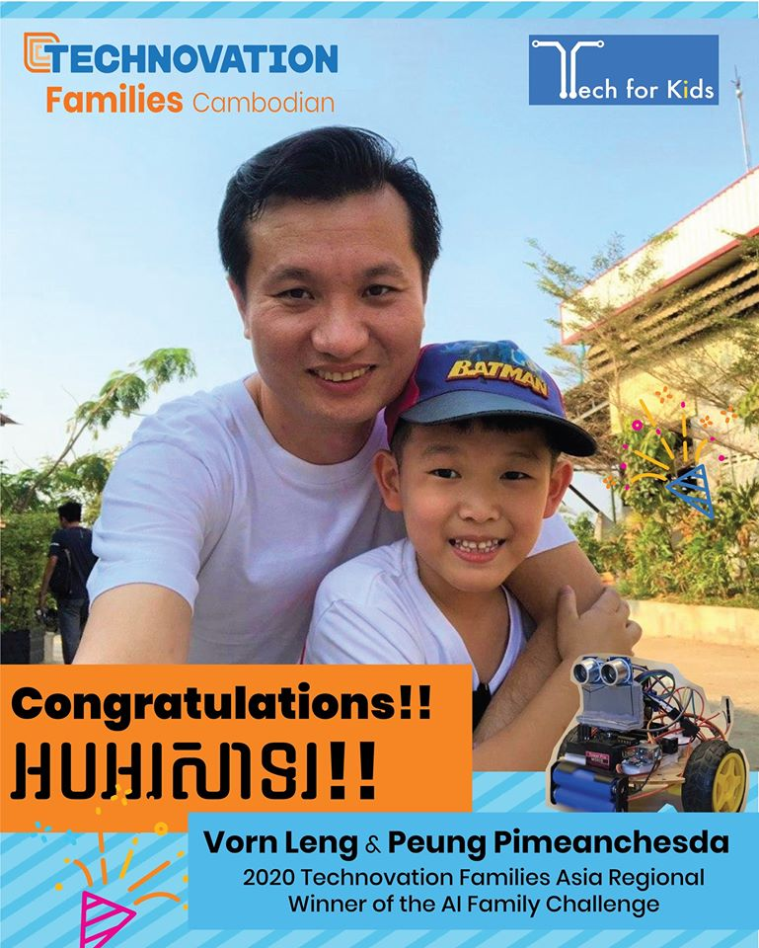
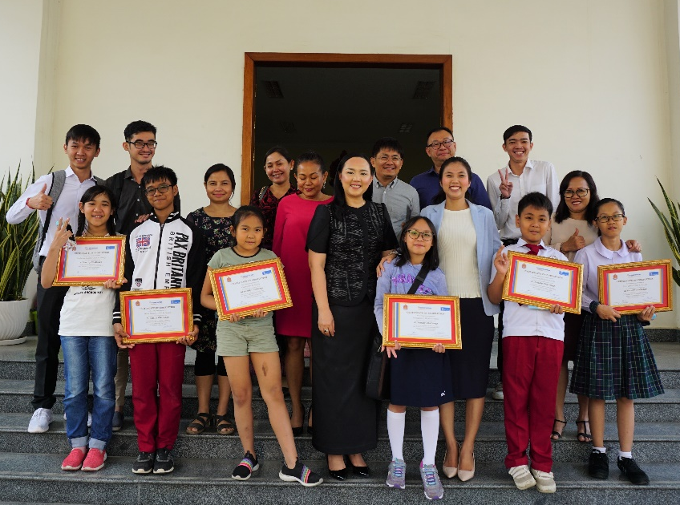
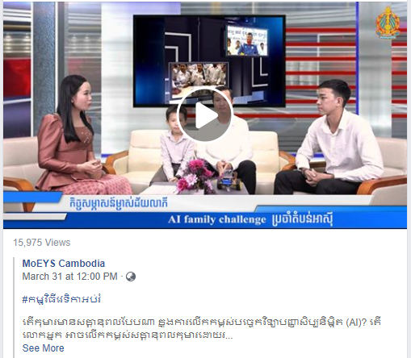
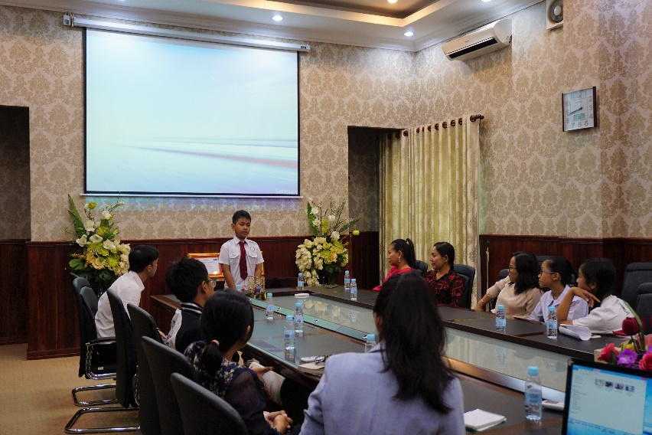
Our Success Story
Technovation Families Asia Regional Winner of AI Family Challenge
Closing Ceremony at MoEYS with H.E. Kim Sethany
Interviewed by MoEYS
Tech for Kids Confidential

Slide 11
Our School Partners
Current Partner
Westline Education Group
Southbridge International School Cambodia
Canadian International School of Phnom Penh
CIA FIRST International School
International School of Phnom Penh
Next Potential Partners
Tech for Kids Confidential
Notes:
Simplify the profile

Slide 12
Company History and Expansion
The most driven tech-education leader in Cambodia
Expand countrywide
Team members 20+
Partner with Singapore Cambodia International Academy (SCIA) and Zhong Ying International School
Official started with 6 team members
Quarter 3 & 4
of 2020
Sept 2019
Quarter 1 &2
of 2020
August 2019
By 2022
Open the first AI education program
Partnering with 3 more schools
Tech for Kids Confidential

Slide 13
Company History and Expansion (Con’t)
Scale to China and other potential territories
Make content more accessible and up-to-dated
Scale to ASEAN
Start with Malaysia & Singapore, Vietnam
2025
2023
2027 onward
Scale to ASIA
Start with Japan and South Korea
Tech for Kids Confidential

Slide 14
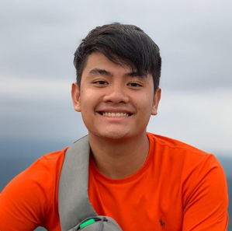
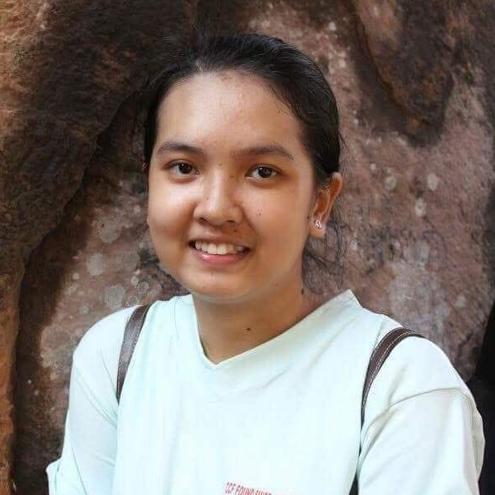
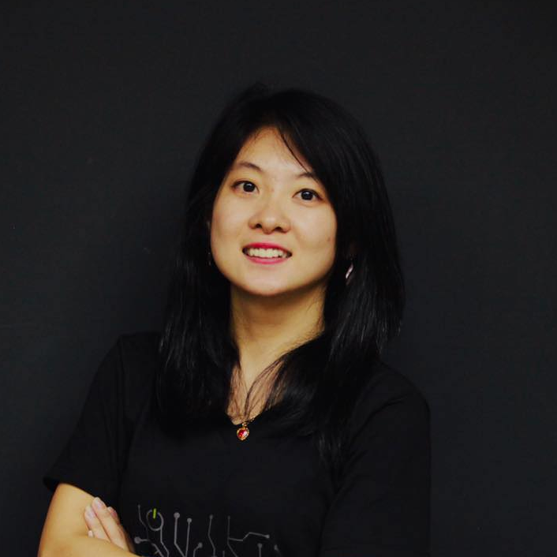
Our Passionate Educators
Lay Keang Hok
AI and Coding
Kann Bonpagna
AI and Coding
Sethy Boreth
Coding and Robotic
Sut Lyladang
Coding
Eath Manith
Coding
Kuok Chamroeun
Kidpreneurs
Huy Sophanna
AI and Coding
Lun Thun Vuthi
AI and Coding
Vuthy Oudomdavid
Coding and Robotic
Lim chandalya
Coding
Saret Dane
Coding
Lay Sivhuang
Kidpreneurs
Tech for Kids Confidential

Slide 15
Our Executive Team
PIDOR Lydet
HORM Chhorleang
HEANG Omuoy
Head of Learning and Business Development
Chief Operating Officer
Head of Partnership and Commercialization
UK’s Chevening Scholar, MSc Business Innovation at the University of London, UK
5 years+ experience with USAID’s ICT Innovation project, and the Ministry of Economic and Finance
Strategic Adviser for Technovation Cambodia.
Bachelor Degree of Science from Paragon International University
4 years teaching experiences
2 years+ experience in startup operation in education sector
1st batch of University Student Development Program 2018 (USDP) Graduate
Recognized Role Model for women in tech-entrepreneurship with national and regional awards on her outstanding leadership
Regional Ambassador of Technovation Cambodia for 3 years
Executive Adviser for Technovation Cambodia.
Tech for Kids Confidential
Notes:
Mentor requirement
Technical skill
Teaching skill and method
Personal interest and Attitude

Slide 16
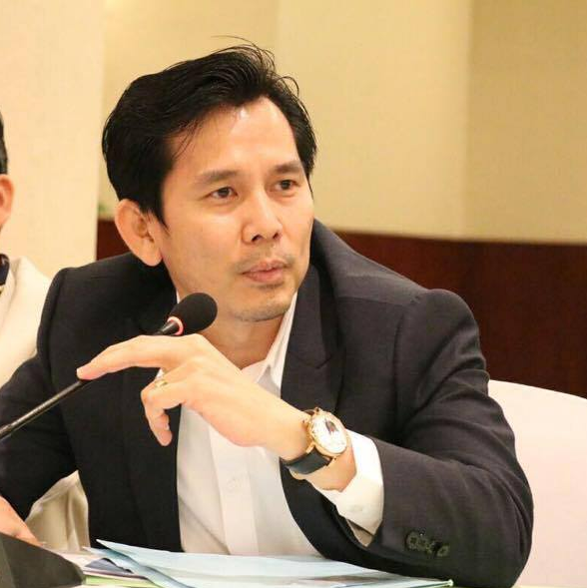
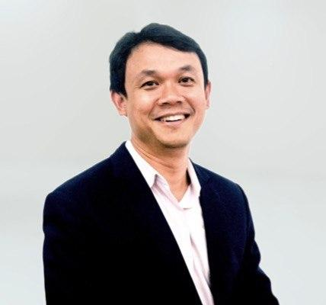
Our Advisory Board
Dr. NGETH Chou
H.E. Dr. TAN Monivann
Dr. LENG Phirom
Financial Advisor
Strategic Advisor
Education and Curriculum Advisor
Independent Director, Finance Specialist, and Investor.
Senior management consultant for 5 years, and also had a 10-year microfinance career primarily in product development, financial services, and investment.
Founding Chair of Solar Energy Association of Cambodia (SEAC), and General Manager who launched French insurance company.
Vice President of Mong Rethy Group
Vice President of Cambodia Chamber of Commerce
Board Advisor of CWEA, YEAC, CYEA, CCA, NTTI, VASWA, HDAC
President of the Kirirom Institute of Technology
Former Head of the Education Unit of the Cambodia Development Resource Institute
Higher education consultant at the Southern University of Science and Technology of China in Shenzhen, China
Founding President of the Comparative Education Society of Cambodia (CESCam)
Tech for Kids Confidential
Notes:
Mentor requirement
Technical skill
Teaching skill and method
Personal interest and Attitude

Slide 17
The leading education provider on tech and entrepreneurship learning for the next generation!
www.techforkids.asia
fb.com/techforkids.asia
chhorleang@techforkids.asia
chhorleang.horm@gmail.com
(+855) 86 248 777
Tech for Kids Confidential

